Slide 1




Creating
SUCCESSFUL
LEARNING
ENVIRONMENTS
SKILLS FOR TEACHERS
This project has received funding from the European Union’s Horizon Europe Research and Innovation Programme under Grant Agreement No. 101061288.

Slide 2


MODULES
01
Strengthening teacher-student relationships
02
Student peer relationships and co-regulation
03
Building effective school - home collaboration

Slide 3

Module 1
STRENGTHENING
STUDENT - TEACHER
RELATIONSHIPS

Slide 4

Module 1 learning objectives
Understand the three dimensions of school engagement and their impact on learning.
Recognize how emotional support and feedback foster student engagement, observe and interpret signs of student engagement or disengagement.
Explore strategies for developing meaningful teacher–student relationships.
Consolidate learning and formulate a personal engagement plan.

Slide 5
School engagement encompasses three key dimensions
Participation in academic and social activities; e.g., homework completion, classroom participation. This reflects how students behave in school and participate in tasks, routines, and social activities.
BEHAVIOURAL
ENGAGEMENT

Slide 6
School engagement encompasses three key dimensions
Emotional reactions to school; e.g., sense of belonging, enjoyment. It includes how students feel about school and their emotional connection to teachers, peers, and the environment
EMOTIONAL
ENGAGEMENT

Slide 7
School engagement encompasses three key dimensions
Investment in learning; e.g., effort, use of learning strategies. This involves mental effort, persistence, and the use of effective strategies to understand and master learning material.
COGNITIVE
ENGAGEMENT

Slide 8

Engaged students are more likely to
See value in their schoolwork:
They recognize how learning is relevant to their lives and future.
Use advanced learning strategies:
These students apply planning, monitoring, and revision techniques.
Experience less anxiety and behavioral problems:
Emotional and academic security helps students manage challenges better.
Achieve better outcomes:
Engagement supports academic growth and personal development.

Slide 9

Disengaged students are at higher risk for:
Anxiety and low motivation:
Disconnection from the learning process can lead to emotional stress.
Behavioral issues:
Acting out, withdrawing, or resisting school rules.
Absenteeism and dropout:
Chronic disengagement can lead to leaving school entirely.

Slide 10

A student consistently completes their homework and joins class discussions.
Which dimension of engagement is most visible here, and what strategies could strengthen the other dimensions?
Quiz
Behavioral engagement; by fostering emotional connection and deeper learning strategies
Emotional engagement; by emphasizing enjoyment of learning
Cognitive engagement; by providing advanced tasks only

Slide 11
Feedback
This example shows behavioral engagement, since the student is following routines and participating actively.
But engagement is multidimensional, so the teacher can also strengthen the student’s emotional connection (e.g., helping them feel valued) and cognitive strategies (e.g., encouraging self-reflection or problem-solving).
A student consistently completes their homework and joins class discussions.
Which dimension of engagement is most visible here, and what strategies could strengthen the other dimensions?

Slide 12

Quiz
A student shows curiosity, asks questions, and persists through challenges. Which type of engagement is most clearly emerging, and how can the teacher also support the other types?
Cognitive engagement; by also reinforcing positive emotions and participation routines.
Behavioral engagement; by encouraging more homework and group work.
Emotional engagement; by focusing only on enjoyment.

Slide 13
Feedback
This is an example of cognitive engagement, because the student invests mental effort and demonstrates persistence.
However, teachers can build on this by supporting emotional engagement (ensuring the student feels safe and motivated) and behavioral engagement (encouraging regular participation in classroom routines).
A student shows curiosity, asks questions, and persists through challenges. Which type of engagement is most clearly emerging, and how can the teacher also support the other types?

Slide 14
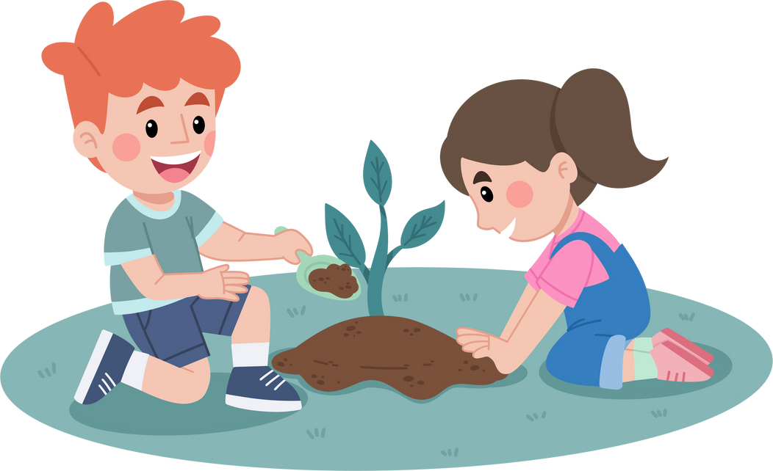
A student says they feel a strong sense of belonging in school and enjoy being with their classmates. What type of engagement is central here, and what classroom practices can nurture the other dimensions?
Quiz
Cognitive engagement; by also reinforcing positive emotions and participation routines.
Behavioral engagement; by encouraging more homework and group work.
Emotional engagement; by focusing only on enjoyment.

Slide 15
Feedback
This example illustrates emotional engagement, since the student feels connected and enjoys school. Teachers can nurture this further by linking it to classroom participation (behavioral) and designing meaningful tasks that stretch the student’s thinking (cognitive).
A student says they feel a strong sense of belonging in school and enjoy being with their classmates. What type of engagement is central here, and what classroom practices can nurture the other dimensions?

Slide 16

Reflection
Think about a time when you noticed moments or events in your class when children were engaged.
What form did it take—behavioral, emotional, or cognitive? What kind of things/aspects/issues were present?

Slide 17
  Emotional support: Encouragement, appreciation, genuine interest
  Perspective-taking: Considering student viewpoints in planning
  Feedback: Clear, high-quality, and actionable
  Classroom climate: Supportive, inclusive, and respectful
Positive teacher–student relationships enhance engagement
Research shows these elements improve engagement and academic success.

Slide 18
  Behavioral: Volunteering answers, joining discussions, on-task behavior.
  Emotional: Positive body language, smiles, relaxed posture.
  Cognitive: Deep questions, expressions of interest, sustained focus, application of new strategies.
Spotting engagement and disengagement
Indicators to look for to spot engagement and disengagement

Slide 19

Positive relationships
Teacher actions
Student emotions
Engagement outcomes

Slide 20
Quiz
Ignore them so they don’t feel pressured
A student is quiet and reluctant to participate during class.
What do you do?
Ask them to answer questions to get them involved
Have a private chat to understand what’s going on and offer encouragement

Slide 21

Ignore them so they don’t feel pressured
Ignoring the student may reduce pressure in the short term, but it risks reinforcing disengagement and missing an opportunity to build trust.
Feedback
Ask them to answer questions to get them involved
A student is quiet and reluctant to participate during class.
What do you do?
Calling on them directly can sometimes help, but it may also increase anxiety if the underlying issue is not understood.
Have a private chat to understand what’s going on and offer encouragement
This is the best option. It shows sensitivity, builds trust, and allows the teacher to tailor support to the student’s needs while reducing pressure in front of peers.

Slide 22
Quiz
Deduct marks and move on
A student regularly doesn’t complete homework.
What do you do?
Talk to them about what's challenging and suggest a new approach
Give the same homework again

Slide 23
Deduct marks and move on
Punishment without understanding the cause may further disengage the student and overlooks barriers to learning.
Feedback
Talk to them about what's challenging and suggest a new approach
A student is quiet and reluctant to participate during class.
What do you do?
This approach acknowledges challenges, shows care, and helps the student take responsibility while exploring strategies for improvement.
Give the same homework again
Repetition without addressing the underlying problem is unlikely to change the outcome and may increase frustration or avoidance.

Slide 24
Reflection
What is one way you show appreciation or interest in your students daily? How might this affect their emotional engagement?

Slide 25

Strategies for building strong connections
Providing emotional encouragement: Celebrate effort and growth, not just outcomes.
Setting goals collaboratively: Involve students in shaping learning objectives.
Using peer collaboration: Facilitate learning partnerships to build social and academic trust.
Adapting approaches: Differentiate tasks and communication styles for student needs.
Understand that engagement varies between students. Identify influencing factors (e.g., personal interests, family background, learning needs).

Slide 26
Review
Engagement is multifaceted: It requires attention to emotions, actions, and thinking.
Relationships are foundational: Students engage more when they feel known and supported.
Using peer collaboration: Facilitate learning partnerships to build social and academic trust.
Reflection and personalization matter: Tailor engagement strategies to your class context.

Slide 27

Formulate your personal engagement plan
When are your students most engaged? What are you doing at those times?
Do certain strategies work for some students and not others? What might explain the difference?
Which relationship-building strategy has had the biggest impact in your class, and why?
Write 3 specific strategies you plan to implement in your teaching to improve engagement. Try to include one each for behavioral, emotional, and cognitive engagement.

Slide 28













This material was developed by the SCIREARLY Project.
SCIREARLY was a three-year long research project funded by the European Union’s Horizon Europe programme.
The University of Helsinki led the part of the research providing the basis for this trainng material.
For more resources on creating learning environments that reduce early scool leaving and promote academic achievement and wellbeing, please visit the SCIREARLY Impact platform at:
www.SCIREARLY.EU
This project has receiThis project has received funding from the European Union’s Horizon Europe Research and Innovation program under grant agreement No. 101061288
Views and opinions expressed are however those of the author(s) only and do not necessarily reflect those of the European Union or the European Research Executive Agency. Neither the European Union nor the European Research Executive Agency can be held responsible for them.

