Slide 1

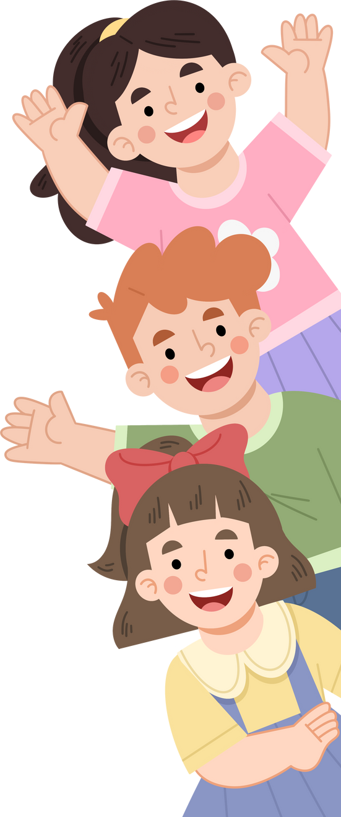


Creating
SUCCESSFUL
LEARNING
ENVIRONMENTS
SKILLS FOR TEACHERS
This project has received funding from the European Union’s Horizon Europe Research and Innovation Programme under Grant Agreement No. 101061288.

Slide 2


MODULES
01
Strengthening teacher-student relationships
02
Student peer relationships and co-regulation
03
Building effective school - home collaboration

Slide 3
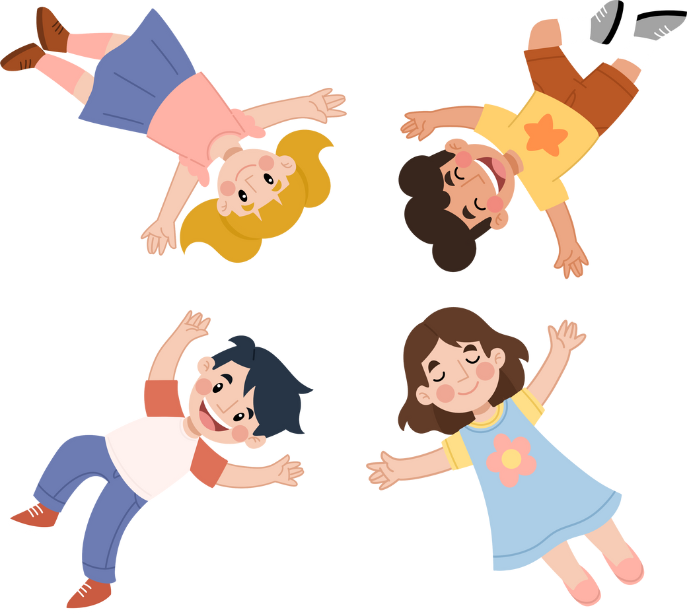
Module 2
STUDENT PEER
RELATIONS AND CO-REGULATION

Slide 4

Module 2 learning objectives
Understand the significance of peer relationships in fostering student wellbeing, engagement and learning.
Explore how teacher behavior and pedagogical design influence student peer relationships.
Understand and apply co-regulation practices that promote collective responsibility and support in learning.
Identify and reflect on obstacles in promoting peer relationships and strategies to overcome them.

Slide 5
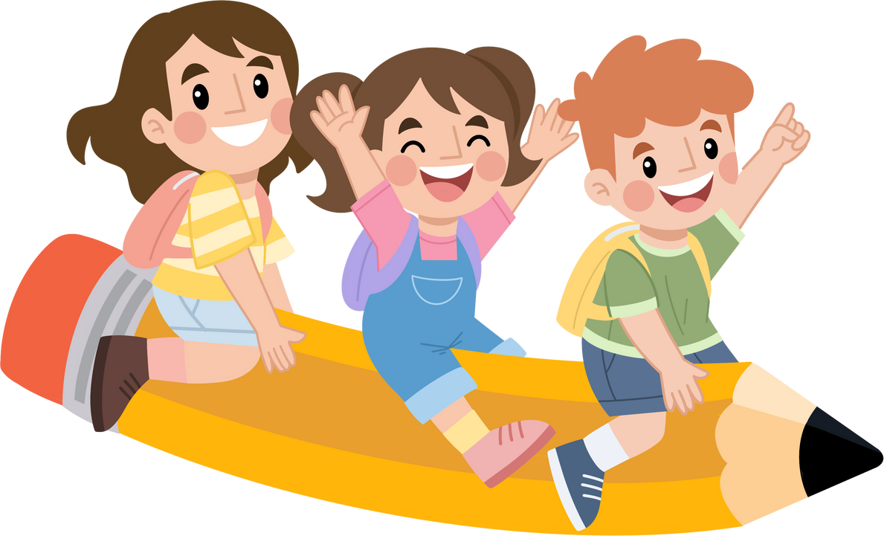

PEER
RELATIONS
Belonging
How belonging fuels engagement
Trust
Co-learning

Slide 6
PEER
RELATIONS
Peer relations refer to the interpersonal connections among students. These relationships are foundational to:
Fostering a sense of belonging: Students need to feel accepted and respected by their peers. This supports emotional security and motivation.

Slide 7
PEER
RELATIONS
Peer relations refer to the interpersonal connections among students. These relationships are foundational to:
Building trust and social support: Peer trust enables help-seeking, emotional sharing, and joint problem-solving.

Slide 8
PEER
RELATIONS
Peer relations refer to the interpersonal connections among students. These relationships are foundational to:
Promoting co-regulation of learning: Students can guide one another in setting goals, monitoring understanding, and adjusting strategies.

Slide 9

Positive peer relations are linked to:
Increased academic motivation: Students are more willing to take learning risks with peer encouragement.
Improved collaboration and social-emotional skills: Such as giving feedback, active listening, and conflict resolution.
Supportive learning climate: Students are more likely to express themselves when they feel emotionally and socially safe.

Slide 10
Negative peer dynamics can lead to:
Loneliness, insecurity, school disengagement
Social exclusion: Rejection or marginalization harms engagement.
Behavioral issues and competition: Unhealthy dynamics may foster power struggles.
School disengagement and dropout: Long-term effects include emotional withdrawal and academic avoidance.

Slide 11
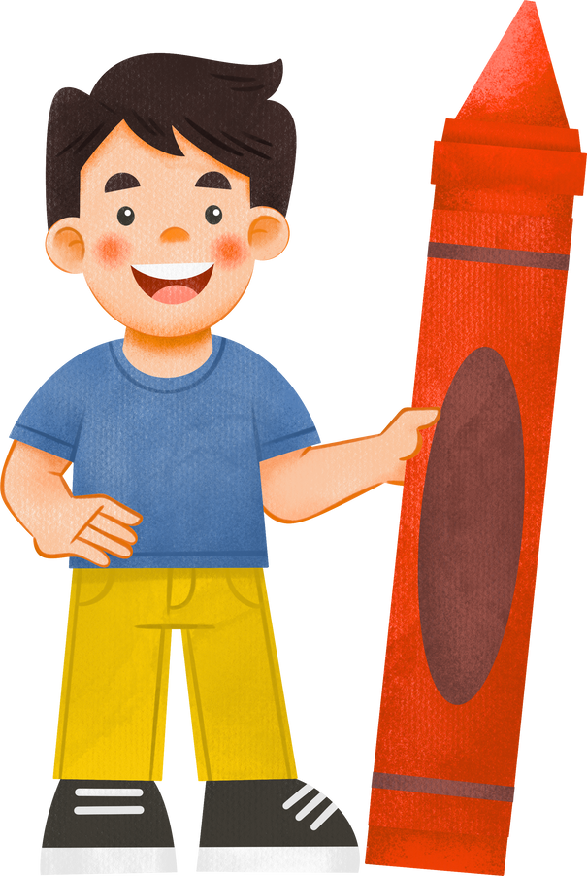
Quiz
Identify which classroom scenarios demonstrate co-regulation or exclusion.
A student invites a classmate to join planning a group project.
A student refuses to work with others and chooses to work alone.
Two students set goals and track their progress together.
A group of students works together, but one student consistently takes the lead while others follow passively

Slide 12
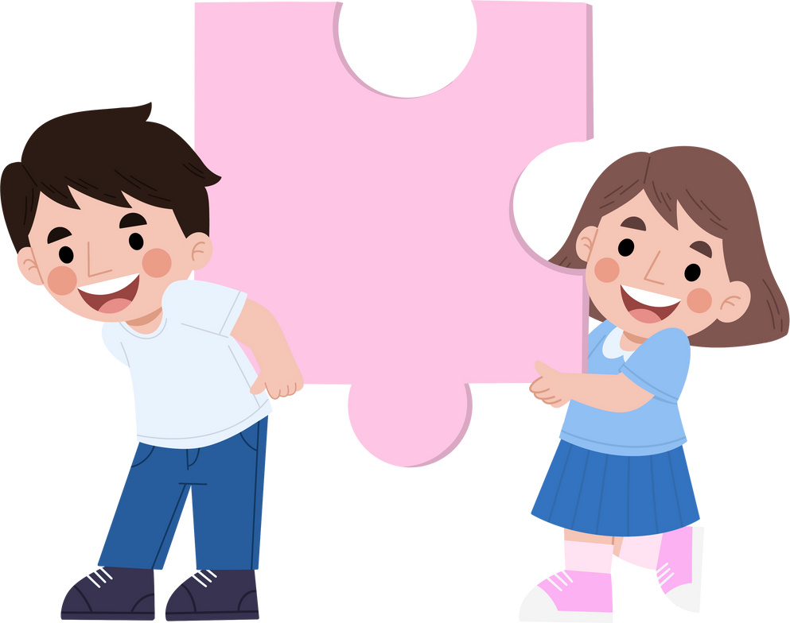
Ignore the behavior unless it becomes a problem
Ignoring exclusion may signal to students that it’s acceptable, which can harm classroom climate and peer trust. Addressing it early helps build a culture of inclusion and respect.
Feedback
Use cooperative activities that require varied groupings
This is the best option. Structured, varied groupings give all students opportunities to collaborate, reduce exclusion patterns, and build broader peer connections. It also models fairness and teacher commitment to inclusion.
Allow students to choose their own groups every time
Giving students choice can sometimes foster comfort, but when used exclusively it may reinforce cliques and exclusion. Balancing choice with structured groupings ensures all students feel included and valued.

Slide 13
Feedback 2
Two students set goals and track their progress together.
This clearly demonstrates co-regulation. The students are actively supporting one another’s learning by setting shared goals, monitoring progress, and providing accountability — all essential skills for collaborative learning.
A group of students works together, but one student consistently takes the lead while others follow passively.
This situation shows some collaboration, but it’s not true co-regulation. When one student dominates, peers miss the chance to share responsibility and regulate learning together. Teachers can step in by assigning roles or prompting equal participation, helping shift from one-sided interaction toward genuine co-regulation.

Slide 14

Reflection
Think of a time when you saw students help each other learn.
What made that moment work? What role did you play?"

Slide 15


Teachers actively shape peer dynamics through:
Interactive classroom structures: Group work and pair activities foster peer connection.
Modeling inclusive behavior: Teachers set the tone through respectful, consistent communication.
Establishing classroom norms: Clear expectations about kindness and cooperation help all students feel safe.

Slide 16
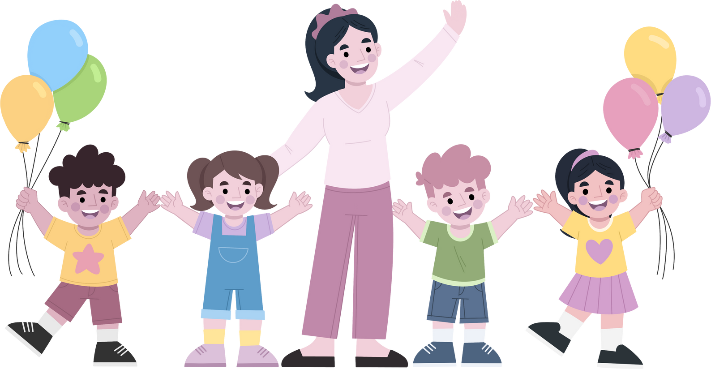
Teachers also influence peer perceptions by:
How they treat each student: Teacher warmth, feedback, and attention impact how peers perceive each other.
Creating a respectful emotional climate: This lowers anxiety and opens space for peer empathy and inclusion.

Slide 17
Quiz
A student often excludes others. What should you do?
Choose the teacher behavior that best supports peer inclusion.
Ignore the behavior unless it becomes a problem
Use cooperative activities that require varied groupings
Allow students to choose their own groups every time

Slide 18

Feedback
A student invites a classmate to join planning a group project.
This is a strong example of co-regulation. By inviting a peer to collaborate, the student supports inclusion, shared responsibility, and joint planning — all of which strengthen engagement and belonging.
A student refuses to work with others and chooses to work alone.
This reflects exclusion, since the student is opting out of peer collaboration. While independent work has value, persistent refusal to join peers can signal disengagement and reduce opportunities to practice teamwork and co-learning.

Slide 19
Reflection
How do you think your daily interactions affect how students treat one another?
Can you give an example?

Slide 20
STRENGTHENING
Co-regulation practices promote collective responsibility and support learning
CO-REGULATION
IN LEARNING

Slide 21
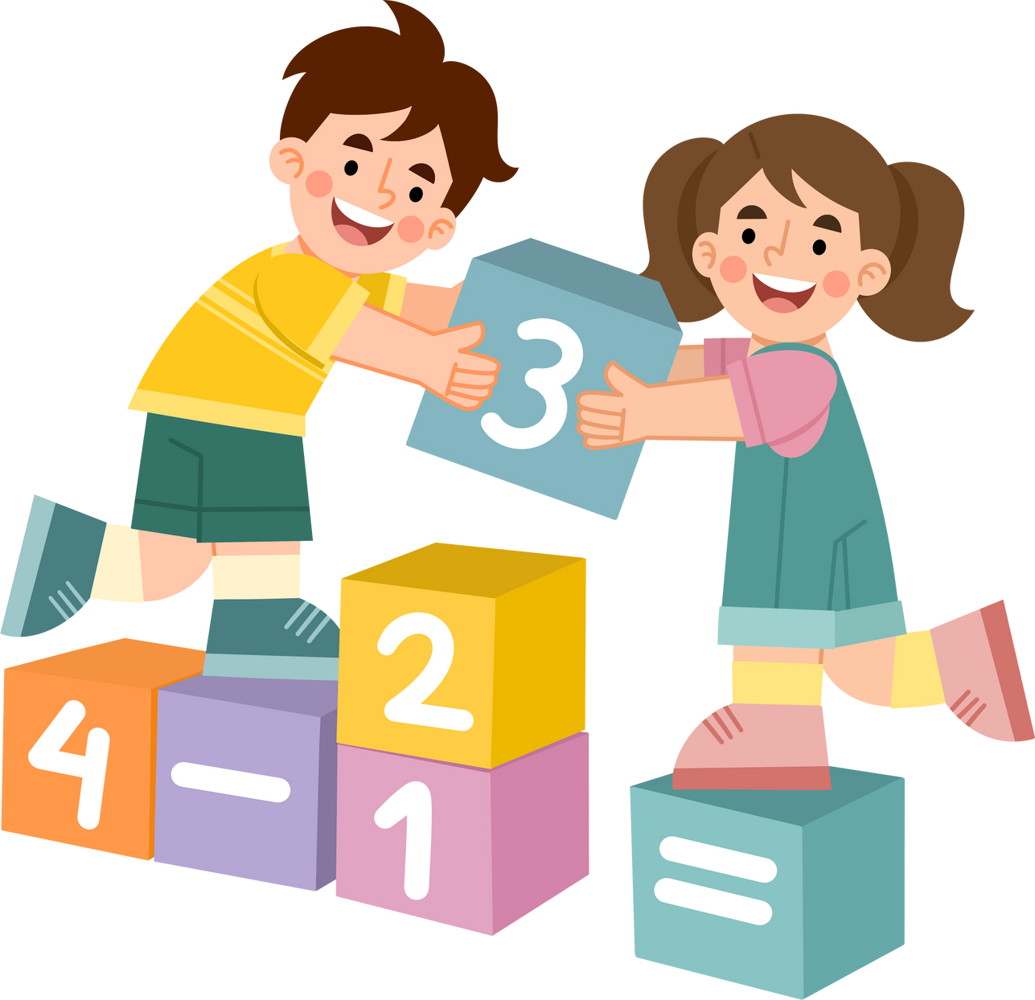
Co-regulation involves:
Shared goal setting:
Students collaborate to define and commit to learning targets.
Mutual monitoring:
They check on each other’s progress and offer support.
Peer coaching and feedback:
Students provide constructive comments to improve each other's work.

Slide 22
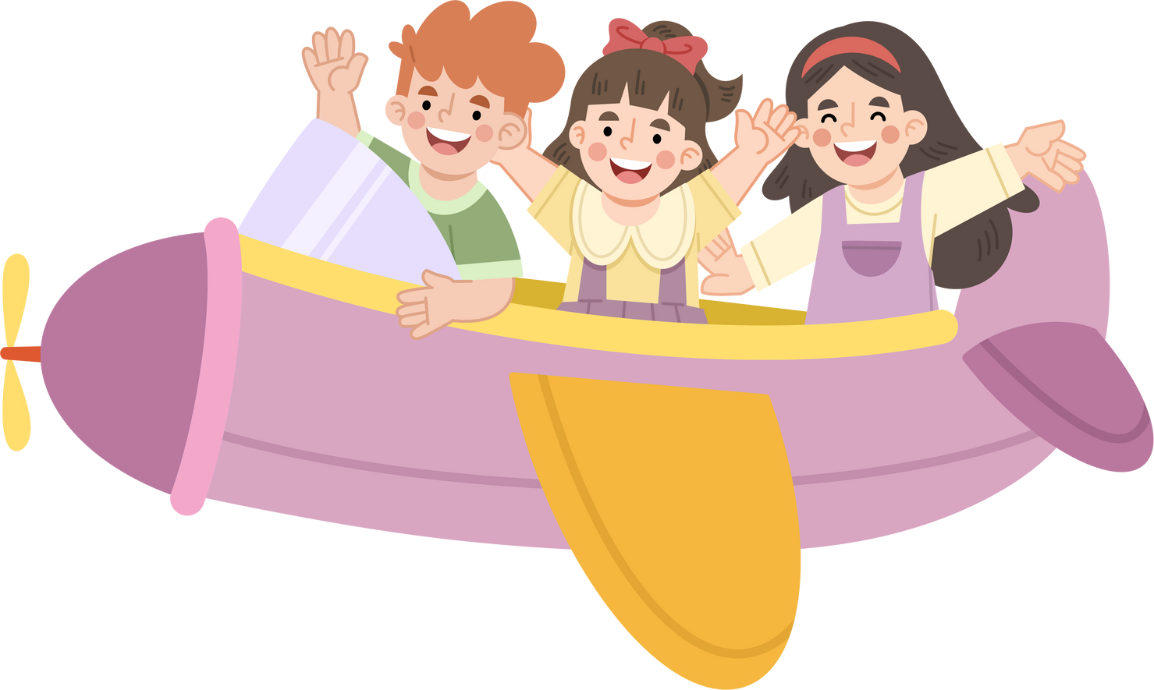
Teachers promote co-regulation by:
Structuring tasks to require interdependence:
Design activities where success relies on collaboration.
Training students in feedback and cooperation:
Provide sentence starters, rubrics, or group roles.

Slide 23

Different levels of co-regulation
Group science project
A group science project requires planning, role-sharing, and collective problem-solving, making it a strong example of high co-regulation. Students depend on one another’s contributions and regulate progress together.
Peer review in writing workshop
Peer review involves students in giving and receiving feedback, monitoring progress, and suggesting improvements. It’s a moderate to high co-regulation activity — the quality of co-regulation depends on how structured the feedback process is.
Whole-class discussion where a few students dominate the conversation:
If only a few voices dominate a whole-class discussion, the activity provides limited co-regulation. Genuine co-regulation happens when responsibility and participation are distributed more evenly by structuring turn-taking, assigning discussion roles, or using small-group formats.
Independent reading log
An independent reading log involves reflection and monitoring, but it’s done individually. This makes it low in co-regulation, since there is little to no peer interaction or shared responsibility.

Slide 24
Reflection
Design a classroom task that promotes co-regulation.
What instructions and supports would you include to guide students?

Slide 25

Navigating challenges and building resilience
Cliques or exclusionary groups: May prevent inclusive collaboration.
Dominance or withdrawal: Some students over-contribute while others avoid participating.
Common challenges
Cultural and social barriers: Differences in communication norms or prior experience can hinder connection.

Slide 26
Navigating challenges and building resilience
Assigning structured roles: Equalizes voice and responsibility.
Rotating group composition: Encourages broader peer interaction.
Teachers can respond by
Using empathy-building strategies: Circle time, stories, or personal reflection activities.

Slide 27
Reflection
What strengths or challenges exist in your class's peer relations?
What obstacles have you seen in peer collaboration?
Rate your comfort level with various strategies | Never | Sometimes | Always
I use structured roles during group work
I pair students intentionally to build diverse connections
I intervene to model inclusive behavior when needed

Slide 28
Re-cap of key practices
Encourage belonging daily: Use rituals, shared responsibilities, and open acknowledgment.
Design co-learning environments: Plan learning that builds academic and social trust.
Teachers can support stronger peer dynamics by
Adapt and observe: Monitor progress and refine approaches as needed.

Slide 29


Formulate your plan for supporting peer relations and co-regulation
When have your students supported each other most effectively? What made it work?
Do some strategies include certain students better than others? Why might that be?
Which activity has had the biggest impact on peer inclusion in your class, and why?
Write 3 strategies you will use to strengthen peer relations and co-regulation — try to include one each for belonging, participation, and co-learning.

Slide 30













This material was developed by the SCIREARLY Project.
SCIREARLY was a three-year long research project funded by the European Union’s Horizon Europe programme.
The University of Helsinki led the part of the research providing the basis for this trainng material.
For more resources on creating learning environments that reduce early scool leaving and promote academic achievement and wellbeing, please visit the SCIREARLY Impact platform at:
www.SCIREARLY.EU
This project has receiThis project has received funding from the European Union’s Horizon Europe Research and Innovation program under grant agreement No. 101061288
Views and opinions expressed are however those of the author(s) only and do not necessarily reflect those of the European Union or the European Research Executive Agency. Neither the European Union nor the European Research Executive Agency can be held responsible for them.

