Slide 1

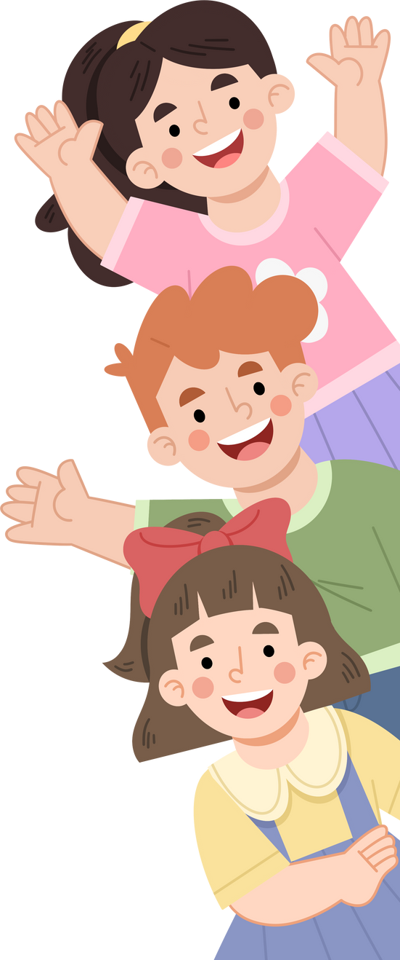


Creating
SUCCESSFUL
LEARNING
ENVIRONMENTS
SKILLS FOR TEACHERS
This project has received funding from the European Union’s Horizon Europe Research and Innovation Programme under Grant Agreement No. 101061288.

Slide 2


MODULES
01
Strengthening teacher-student relationships
02
Student peer relationships and co-regulation
03
Building effective school - home collaboration

Slide 3
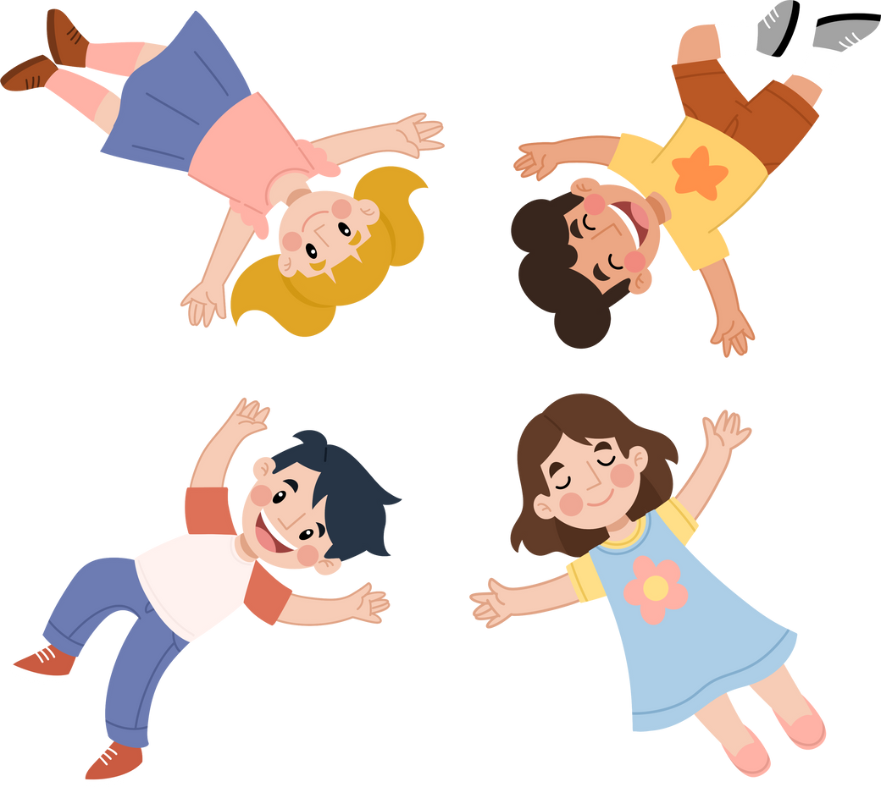
Module 3
BUILDING EFFECTIVE
SCHOOL - HOME
COLLABORATION
SKILLS FOR TEACHERS

Slide 4

Module 3 learning objectives
Understand the significance of teacher–guardian collaboration in student learning, wellbeing, and school engagement.
Explore how shared goals between teachers and guardians create a coherent support network for students.
Identify how school - home collaboration can be used to prevent school disengagement and support learning proactively.
Explore practical strategies for engaging all guardians, including those who may be harder to reach.

Slide 5
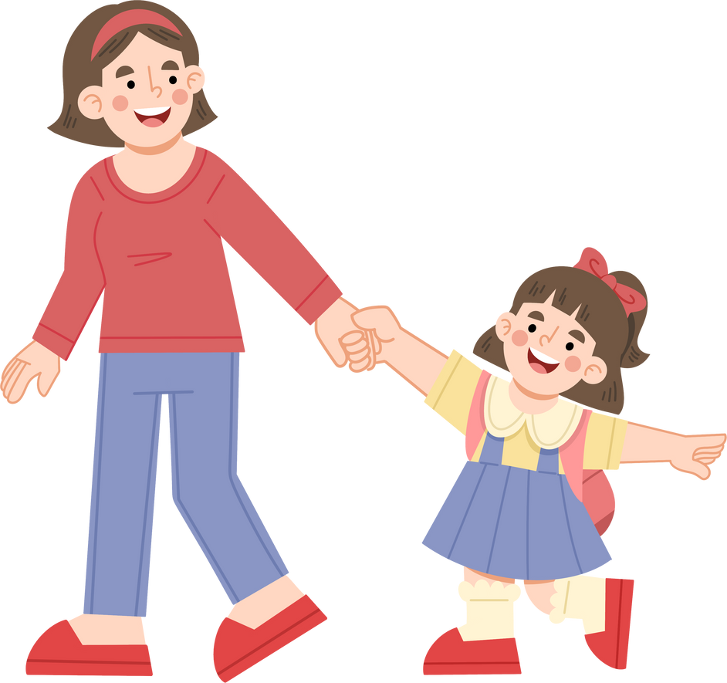
Academic achievement
Attendance and retention
BENEFITS OF
PARENTAL INVOLVEMENT
How belonging fuels engagement
Lower drop-out rates
Wellbeing and beahviour

Slide 6

BENEFITS OF
Academic achievement: Students with involved parents tend to perform better across subjects. This connection holds regardless of background or income level.
PARENTAL INVOLVEMENT
Attendance and retention: When families are engaged, students are more likely to attend regularly and stay in school.
Extensive research demonstrates that parental involvement in schooling positively affects:
Wellbeing and behavior: Students experience better emotional health and fewer behavior problems.
Lower dropout rates: Parental support is a strong predictor of continued school engagement.

Slide 7
BENEFITS OF
Parental engagement is beneficial regardless of income or background.
PARENTAL INVOLVEMENT
Students perform better when schools communicate clear expectations and support for parent involvement.
Key findings from research
Emotional engagement with school is often linked to positive parental involvement.

Slide 8

Reflection
Think of a situation where a guardian’s involvement made a difference for a student in your class.
What happened?

Slide 9

Strong collaboration is built on:
Reciprocity: Teachers and guardians engage in two-way communication where both feel heard and respected.
Alignment of goals: Everyone supports the student’s learning with a common vision and coordinated efforts.
Open and intentional communication: Regular, positive contact initiated by the school builds trust and inclusion.

Slide 10
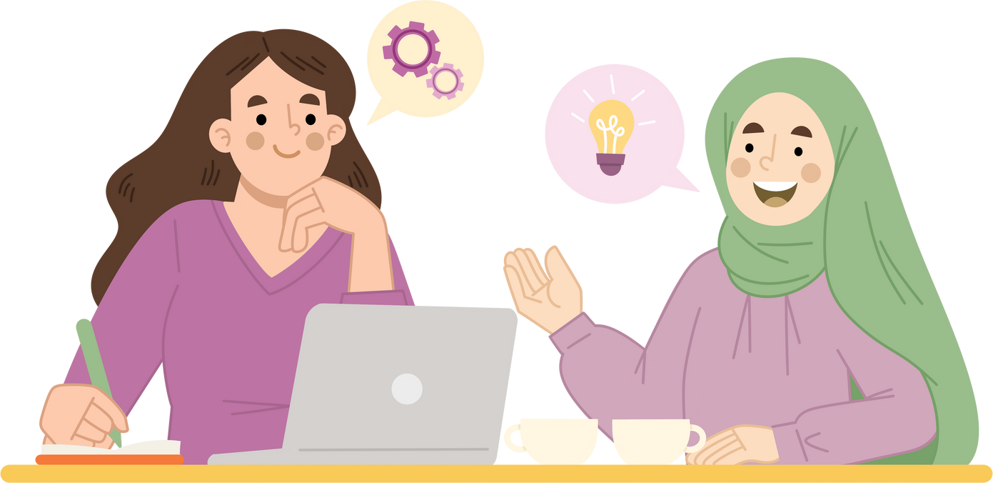
When collaboration is aligned:
Students feel protected and supported
Teachers and guardians can address issues proactively
There’s a stronger foundation for academic and social success

Slide 11
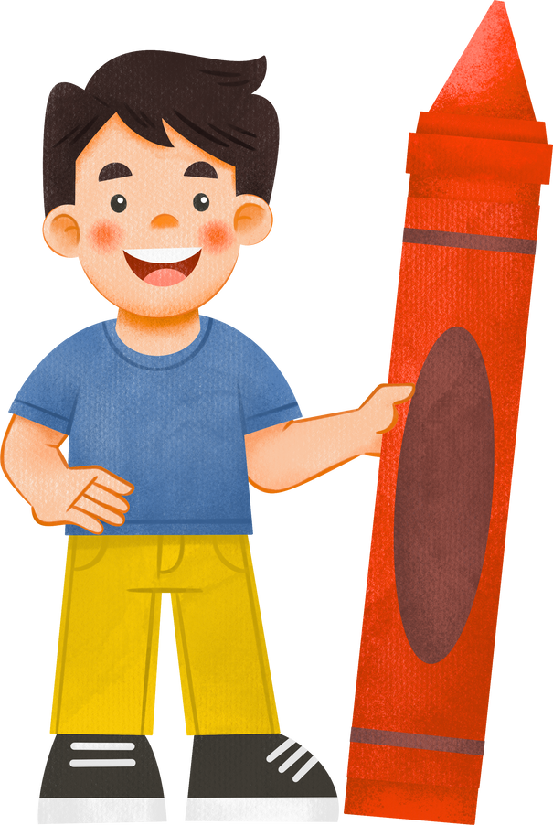
Quiz
A parent seems disengaged during meetings. Which strategy aligns best with reciprocal collaboration?
Provide a summary of their child’s strengths and invite input
Focus only on areas of concern
Skip regular updates

Slide 12
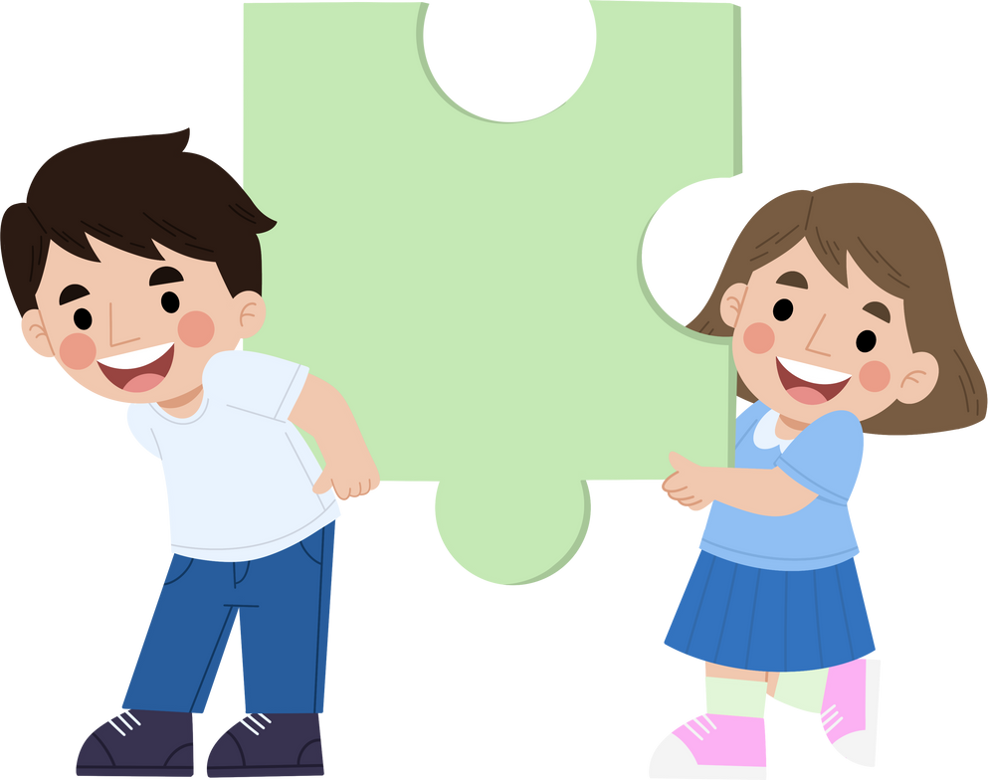
Provide a summary of their child’s strengths and invite input
This is the best choice. Starting with strengths shows respect and builds trust, while inviting input makes collaboration reciprocal. It helps parents feel valued and more willing to engage in meaningful dialogue.
Feedback
A parent seems disengaged during meetings. Which strategy aligns best with reciprocal collaboration?
Focus only on areas of concern
Concentrating only on problems can discourage parents and reinforce disengagement. Without highlighting strengths or inviting their perspective, it risks making collaboration one-sided and deficit-focused.
Skip regular updates
Avoiding contact can deepen disengagement and prevent parents from becoming partners in their child’s learning. Consistent communication, even brief, positive updates, is key to building ongoing trust and reciprocity.

Slide 13
Reflection
Think of a time when a parent seemed less engaged. How did you respond?
Looking back, what could you do to make the conversation more reciprocal? How could you approach parents with small steps to build the connection and relationship conveniently?

Slide 14
BENEFITS OF
Issues are identified early: Teachers and guardians can intervene before problems escalate.
PRO-ACTIVE SCHOOL - HOME COLLABORATION
Learning progress is monitored collaboratively: This ensures a continuous support system around the student.
Guardians should be included not only during problems but as partners in ongoing development.
Disengagement is reduced: Students feel less isolated and more encouraged to stay on track.
Teachers can invite discussions not just about problems, but also about learning plans, progress, and student strengths.

Slide 15

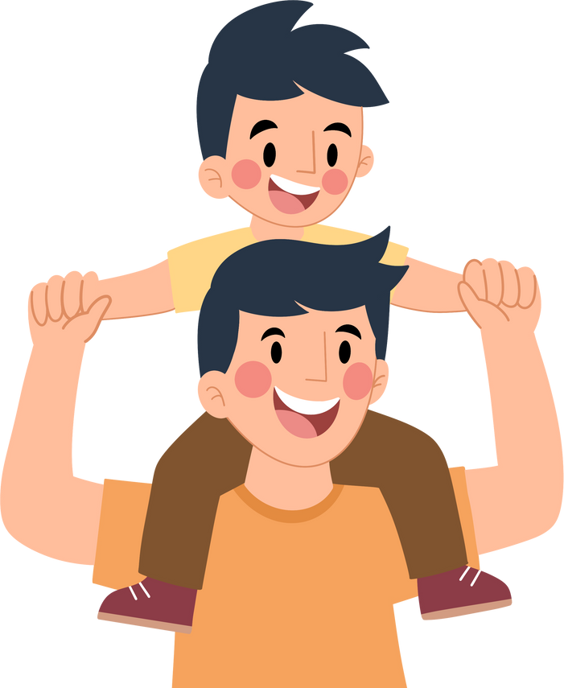

Benefits of proactive school – home collaboration
Regular check-ins
Early problem detection
Student-led conferences
Strengthened student agency
No outreach unless there’s a problem
Missed opportunities

Slide 16
Reflection
Describe a time you prevented a potential issue by involving a guardian early.
What was the result?

Slide 17
MAKING COLLABORATION
Flexibility in communication: Provide multiple ways for guardians to engage, including digital and in-person options.
PRACTICAL AND INCLUSIVE
Cultural awareness: Understand and respect families’ diverse backgrounds and communication styles.
Key principles of inclusive school -home collaboration
Student-centered meetings: When appropriate, involve students to enhance transparency and self-advocacy.
Strength-based focus: Highlight what students do well and build on it together.

Slide 18
Which methods do you use for involving guardians?
Personal phone calls
Parent–teacher conferences
Student-led meetings
Joint student-teacher-parent meetings
Messaging apps or digital platforms

Slide 19
Reflection
What has been rewarding in your collaboration with guardians?
What challenges have you faced, and how did you address them?

Slide 20
To build a stronger partnership with guardians:
Engage early and often: Don’t wait for problems to arise.
Make collaboration visible and purposeful: Share how and why you are involving guardians.
Keep the focus on the student: Shared goals for student growth guide meaningful discussion.
Consistent, intentional collaboration can transform the school experience for students and families.

Slide 21
MAKING COLLABORATION
Flexibility in communication: Provide multiple ways for guardians to engage, including digital and in-person options.
PRACTICAL AND INCLUSIVE
Cultural awareness: Understand and respect families’ diverse backgrounds and communication styles.
Key principles of inclusive school -home collaboration
Student-centered meetings: When appropriate, involve students to enhance transparency and self-advocacy.
Strength-based focus: Highlight what students do well and build on it together.

Slide 22
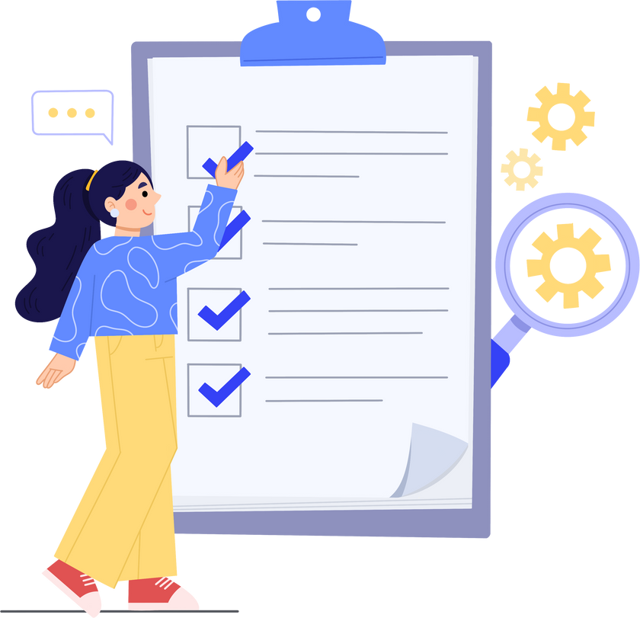

Formulate your plan for stronger school-home collaboration
When have you seen family involvement make the biggest difference for a student? What factors contributed?
Do certain approaches work better with some families than others? Why might that be?
Which collaboration strategy has had the strongest impact on student engagement in your class, and why?
Write 3 strategies you will use to strengthen school–home collaboration — try to include one each for early engagement, inclusivity, and ongoing communication.

Slide 23
Quiz
A guardian shows frustration at a lack of updates. What do you do?
Defend your current system
Ask how they prefer to receive updates and adjust accordingly
Schedule fewer meetings

Slide 24
Defend your current system
Defending the system without listening may escalate frustration and signal that the parent’s concerns aren’t valued. Reciprocal collaboration requires openness and flexibility.
Feedback
Ask how they prefer to receive updates and adjust accordingly
This is the best approach. By asking about their preferred communication style and adjusting where possible, you show respect, build trust, and make collaboration practical and inclusive.
A guardian shows frustration at a lack of updates. What do you do?
Schedule fewer meetings
Reducing contact may further alienate the guardian and reinforce their sense of exclusion. Parents generally want more meaningful connection, not less, especially when they are already asking for updates.

Slide 25
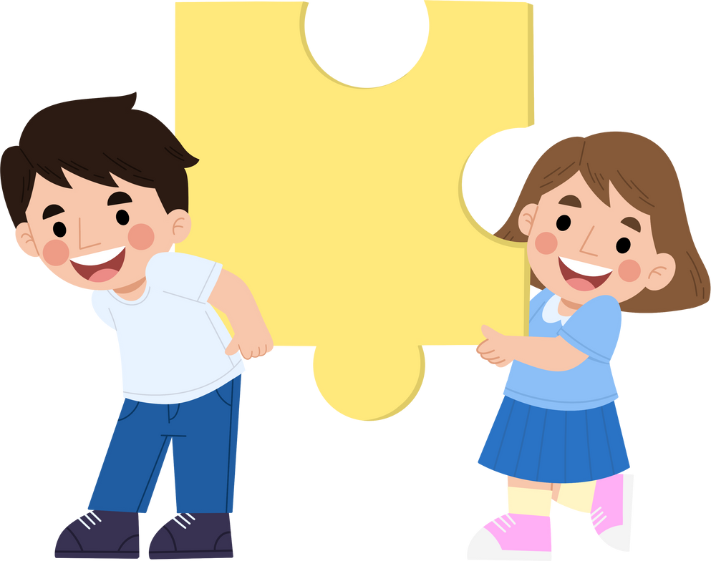
Feedback
Defend your current system
Defending the system without listening may escalate frustration and signal that the parent’s concerns aren’t valued. Reciprocal collaboration requires openness and flexibility.
A guardian shows frustration at a lack of updates. What do you do?
Ask how they prefer to receive updates and adjust accordingly
This is the best approach. By asking about their preferred communication style and adjusting where possible, you show respect, build trust, and make collaboration practical and inclusive.
Schedule fewer meetings
Reducing contact may further alienate the guardian and reinforce their sense of exclusion. Parents generally want more meaningful connection, not less, especially when they are already asking for updates.

Slide 26













This material was developed by the SCIREARLY Project.
SCIREARLY was a three-year long research project funded by the European Union’s Horizon Europe programme.
The University of Helsinki led the part of the research providing the basis for this trainng material.
For more resources on creating learning environments that reduce early scool leaving and promote academic achievement and wellbeing, please visit the SCIREARLY Impact platform at:
www.SCIREARLY.EU
This project has receiThis project has received funding from the European Union’s Horizon Europe Research and Innovation program under grant agreement No. 101061288
Views and opinions expressed are however those of the author(s) only and do not necessarily reflect those of the European Union or the European Research Executive Agency. Neither the European Union nor the European Research Executive Agency can be held responsible for them.

